Slide 1
Code
camp
Make coding a STEM superpower
Notes:
(10s) Hi everyone, we’d like to introduce CodeCamp, a five-week programme designed to help NMES students with no coding experience to build confidence in programming.

Slide 2
Code
camp
Make coding a STEM superpower
Notes:
(10s) Hi everyone, we’d like to introduce CodeCamp, a five-week programme designed to help NMES students with no coding experience to build confidence in programming.

Slide 3



TEAM
Bianca Bodrug
Shreya Shah
Bobby Vu
Partnership &
Programme Coordination
BSc Chemistry with Biomedicine (Year 2)
Marketing
& Communications
BSc Chemistry with Biomedicine (Year 2)
Curriculum &
Teaching
MSc Advanced
Software Engineering
Notes:
(10s) Our team includes:
Bia, who’s in charge of Partnership & Coordination
Shreya, who’s doing Marketing
And me, Bobby, who’s doing Curriculum & Teaching.

Slide 4

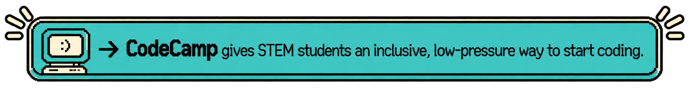
CODING IS INCREASINGLY IMPORTANT, BUT NOT ALWAYS ACCESSIBLE TO STEM STUDENTS
STEM courses increasingly involve computational and data skills
Students have analytical skills but not able to translate them to employability
AI make coding easier to start, but fundamentals still matter
Notes:
(40s) The problem we are trying to solve is that: while coding is an important skill, it is not always accessible to STEM students.
Firstly, STEM courses involve computational and data skills, but students do not always receive enough structured support to learn programming.
Secondly, STEM students have strong analytical skills but don’t know how to translate those into employable skills.
Also, AI has made coding easier to start, but the fundamentals still matter to evaluate AI-generated code rather than relying on it blindly.
This is where CodeCamp comes in: it provides an inclusive and low-pressure entry point for students to learn to code.

Slide 5

CODECAMP: A 5-WEEK PRACTICAL
PYTHON PROGRAMME
WEEK 1-3:
Python
fundamentals
Core programming concepts, functions, data structures, debugging and best coding practices
Apply Python to real STEM data by learning how to clean, analyse and visualise datasets
WEEK 4:
Data analysis
Use GitHub and simple deployment tools to build, publish and share a working Python project
WEEK 5:
Build & share
Notes:
(30s) Our solution is a five-week Python programme designed for STEM students with no coding experience.
In Weeks 1 to 3, we will build their foundations in Python and cover concepts such as functions, data structures and debugging.
In Week 4, students will apply those skills to STEM data by learning how to clean, analyse and visualise datasets.
In Week 5, we will help students deploy their projects and learn GitHub.

Slide 6


CODECAMP AIMS TO MAKE
ALL STEM STUDENTS CONFIDENT CODERS
By the end of CodeCamp, we want students to…
CODE WITH
CONFIDENCE
BECOME INDEPENDENT LEARNERS
EXPAND
CAREER OPTIONS
Use Python
independently
Build the skills to pick up new tools and languages
Recognise coding as
future career paths
Notes:
(30s) OUR GOALS: By the end of CodeCamp, we want students to…
(1) …feel confident using Python independently and understanding the fundamentals.
(2) We also want them to become independent learners who can pick up any new languages easily.
(3), We want students to understand how programming can connect their STEM background to tech careers.
--
Overall, five weeks is only a starting point.
Our aim is to give students enough of a foundation that coding stops feeling like a barrier and becomes a skill they feel confident continuing to develop.

